Slide 1


Slide 2
Introduction to Git and GitHub | Open-Source Contributions
Ayush Rathore

Slide 3
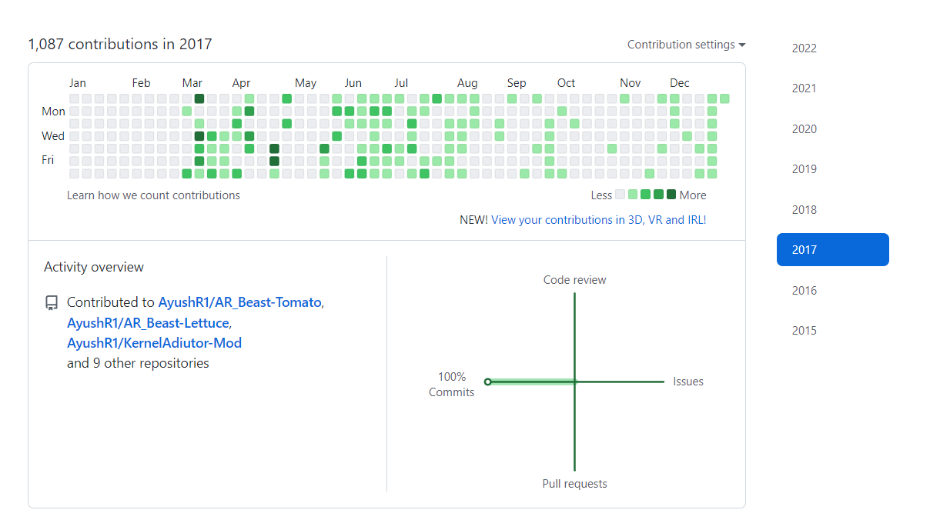
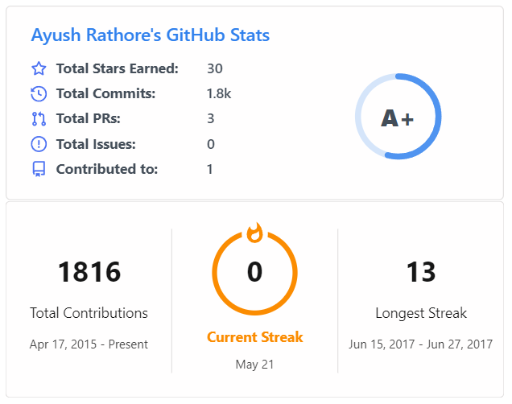

Slide 4
Challenges…
Suppose you are a software developer working in google microsoft.
Suppose you made the camera app.
Now you want to add camcorder feature to it.
While doing the changes on the code. You made a mistake, and now the whole thing doesnt works.
Now What to do???

Slide 5
What is git?

Slide 6
What is git?
It is a version control system that records changes to a file or a set of files over time so that you can recall to specific versions later.
It allows you to –
•Revert the selected files back to a previous state,
•
•Revert the entire project back to a previous state,
•
•Compare changes over time,
And Many more which you will see…

Slide 7
What is version control?

Slide 8
Story conclusion
Using Git in a group project allows for several developers to work on the same project independently without constantly interfering with each other’s input. Each developer can get an independent version of the code that they can modify without taking the risk of destroying a stable version of the code.
The ability to duplicate the code and work independently on a different version of it makes Git a good option for anyone building an application, even a developer working alone. It gives you the opportunity to keep several versions of your code and keep track of all characteristics of each change, such as who did the change and when.

Slide 9
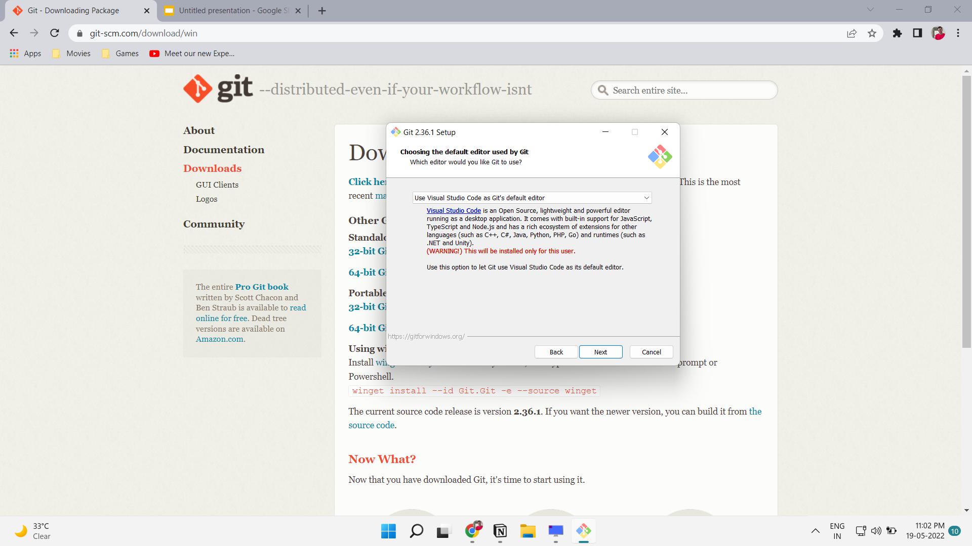
Download and Install Git
https://git-scm.com/downloads ** while instaling Make default editor Notepad or VSCode

Slide 10
Setup
First Setup your identity.
Type the following commands
$ git config --global user.name "Your Name"
$ git config --global user.email your.email@example.com
Eg.

Slide 11

Hands on Workshop
git init
git status
git add
git commit
git log
git branch
git branch <new-branch-name>
git checkout <existing-branch-name>
git diff

Slide 12
What is GitHub?

Slide 13
What is GitHub?
FIrst of all GitHub is not git.
GitHub is a website for hosting projects that use git. Its live google drive for your git repositories.
GitHub is one of the most popular platforms for Version Control.
If Git is the ingredient, GitHub is the final product.
Largest hub of open-source software.

Slide 14

Hands on Workshop

Slide 15
git remote add origin link.git
git branch -M main
git push -u origin main
git clone link.git
git revert commit_hash
git cherry-pick commit_hash

Slide 16
Open-Source Contributions

Slide 17
Resources:-
Check the repository where you made your first contributions.

Slide 18
Thank
You

